Slide 1
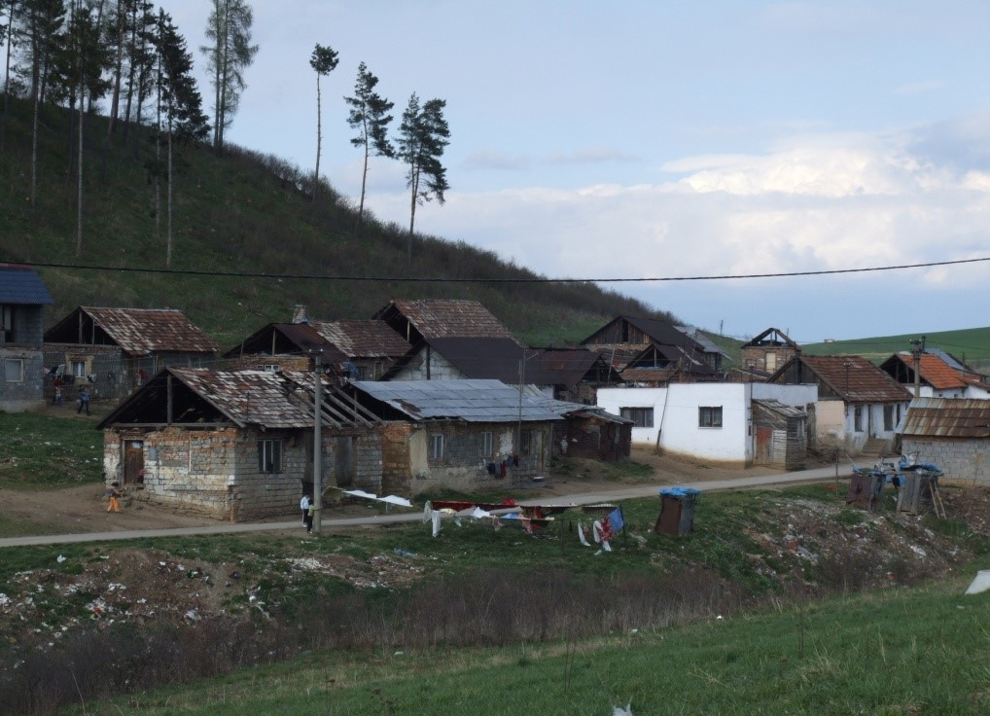
Experience, problems and challenges related to excluded Roma communities in municipalities
EPHA 6th Annual Conference 2015 Side event, Thursday,
3 September 2015
Marek Virág
Mayor of the village - Markušovce

Slide 2
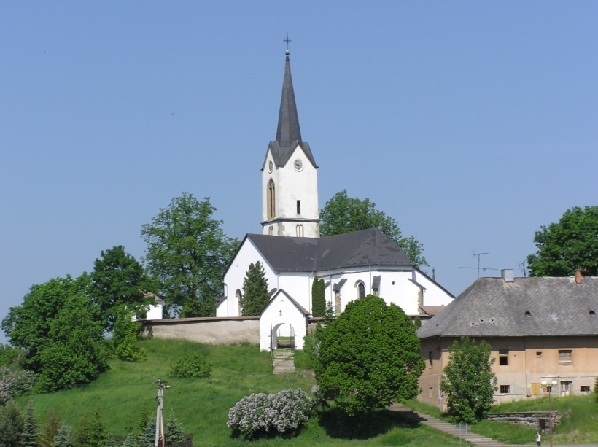
Markušovce village
Markušovce lays in east Slovakia in the Spišská Nová Ves district and is part of the Košice region.
The village of Markušovce is currently the centre on the micro-regional level and its population of 4 225 attributes it to a large Municipality.
According to the municipality’s research Roma inhabitants make up 60.33% of the overall population.

Slide 3
Markušovce Roma inhabitants
Members of the Roma community in the municipality amount to 2 549 and constitute 60.3% of the overall population.
Roma settlements | number
Separated settlement „Jareček“ | 1 979
„Za tehelňou“ | 216
„Hamrisko“ | 72
Ulica Pod horou | 14
Ulica Sv. J. Nepomuckého | 109
Markušovce 0 | 73
Ulica Odorínska cesta | 23
Ulica Michalská | 63
The data is approximate because not all members of the Roma community officially reside in the municipality.
In terms of the difficult situation in the municipality and the high Roma population rate, it is essential that sufficient attention be given to the specific conditions in which the population lives.

Slide 4
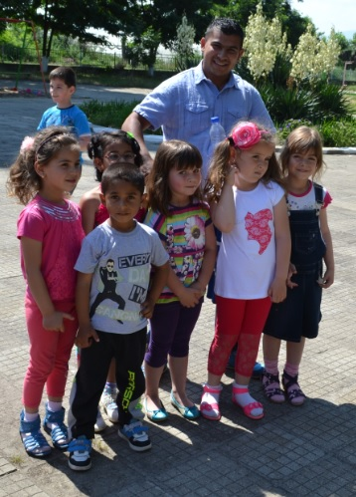
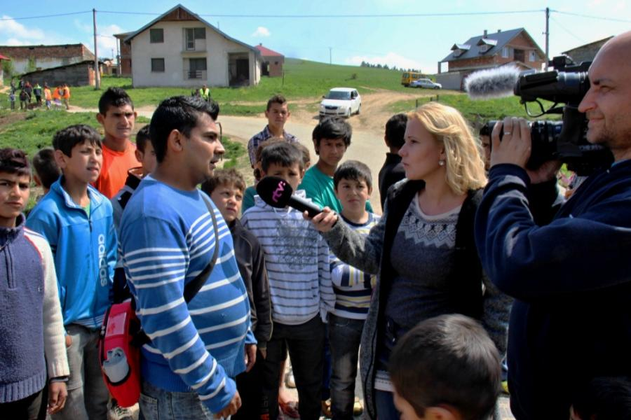
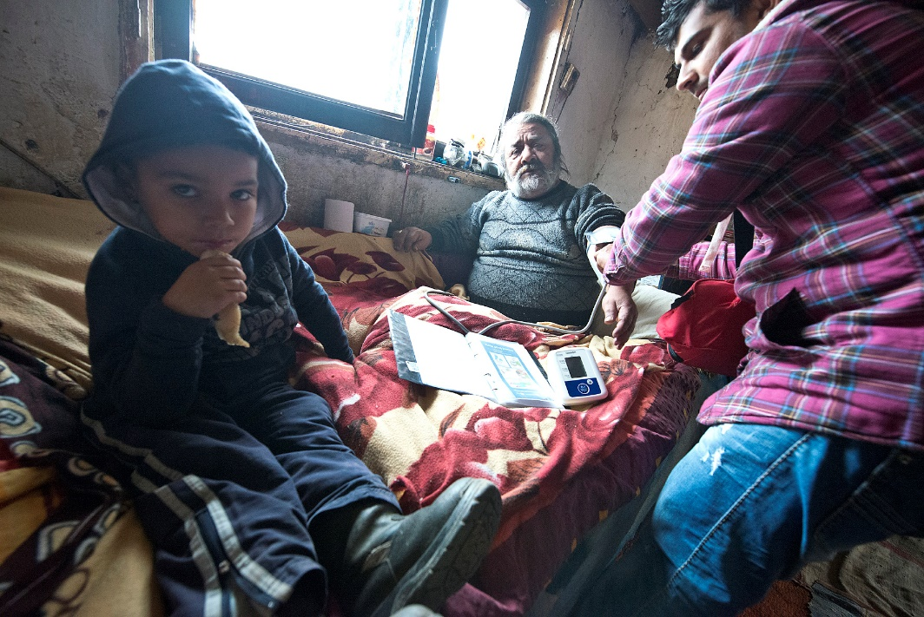
Health mediators in our municipality
A person who unites all the inhabitants
The only person we have at the moment
Inspires and motivates the Roma community in our municipality – serves as an example
Assists, supports, advises and resolves many problems in the field of health
a
Currently only health mediator works in our village.

Slide 5
The health mediator’s role in Markušovce
Spreading health education in Roma settlements
Preventative check-ups – the assistant invites inhabitants for compulsory and preventative check-ups
Taking medicine and information on its use
Child and adult inoculations currently stand at 100% in our municipality
Midwife and injury assistance is irreplaceable
Collaboration with doctors in the municipality is at a very high level (we have a healthcare facility in the municipality)
Close cooperation with physicians during diagnosis where the assistant can name the symptoms of the disease;
Cooperation with the Regional Office for Public Healthcare on infectious diseases which regularly affect the community
The assistant explains to the inhabitants of Roma settlements what their rights and responsibilities regarding health care are in terms of what is provided by doctors, health clinics and hospitals
Cooperation with local authorities, primary schools and kindergartens in the municipality of Markušovce on spreading awareness of health.
Notes:
1, osveta: (na OZ asistent predložil žiadosť na zabezpečenie liečby ochorenia MUMPS)

Slide 6
The required tools for positive change in our municipality
Improvement of the dwelling infrastructure in Roma settlements
A kindergarten
A community centre
Employment - the establishment of a social enterprise
The Construction of water and sewer connections
Communal waste – separating waste and the provision of waste disposal
Health Mediator action for as long as possible.

Slide 7
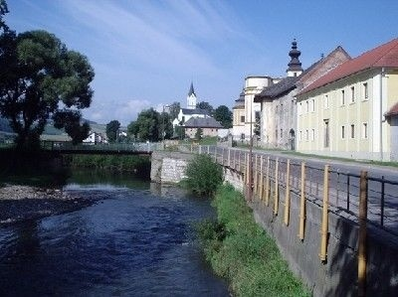
Thank you for your attention
Marek Virág
starostaocu@markusovce.sk

