Slide 1
For us-By us

Slide 2
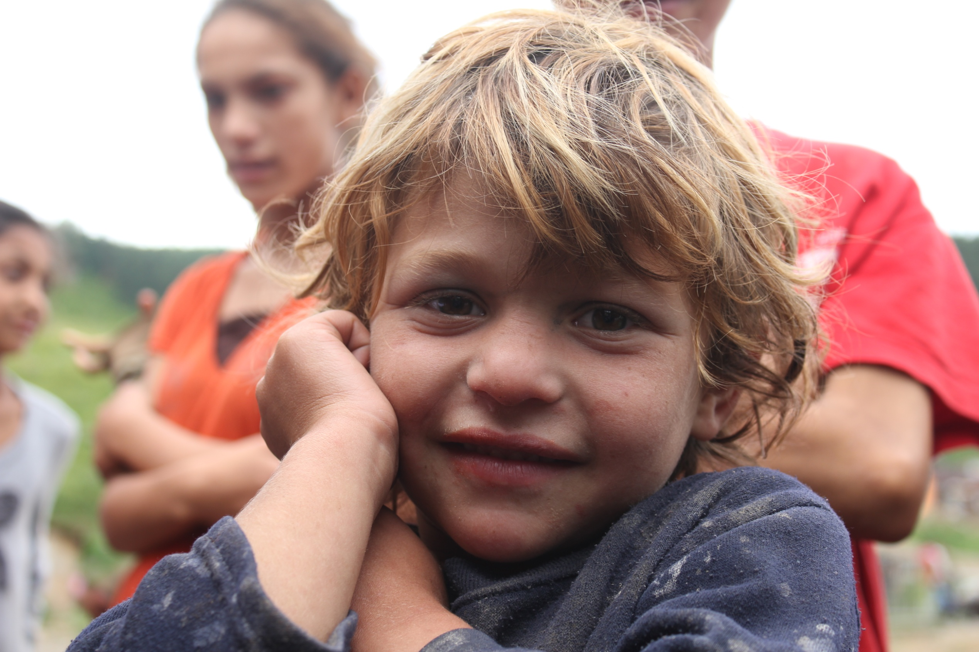

Slide 3
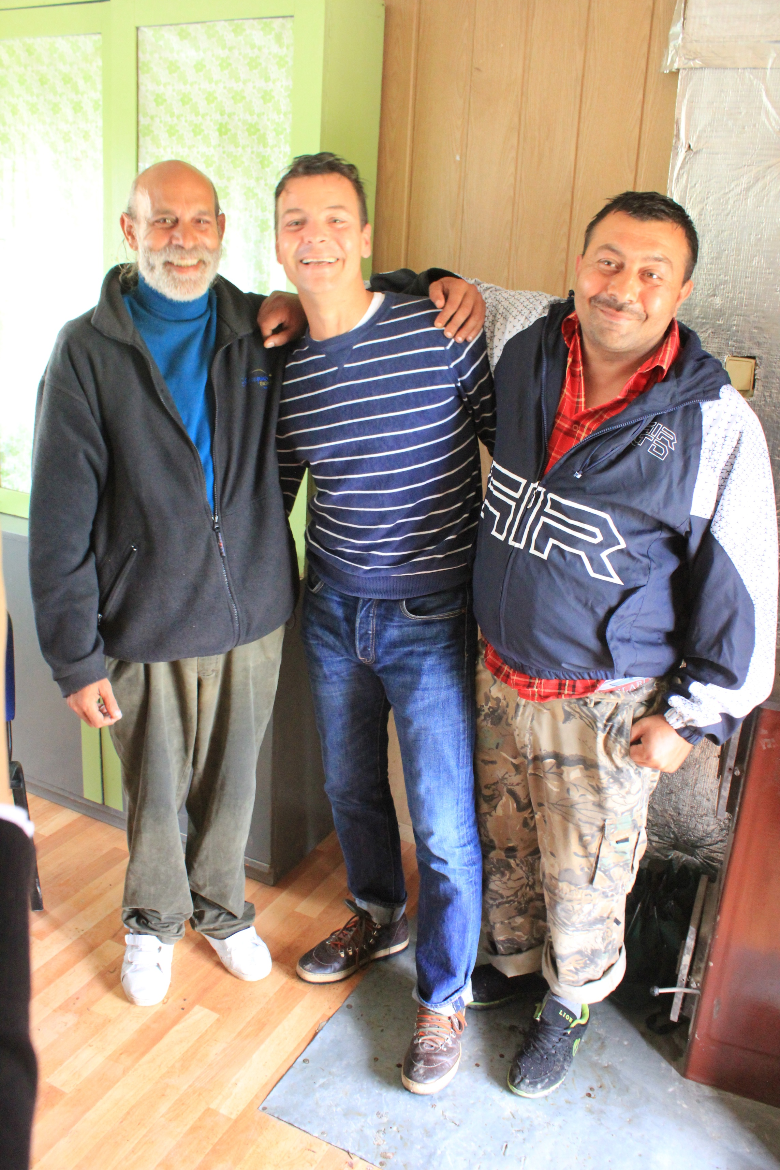

Slide 4
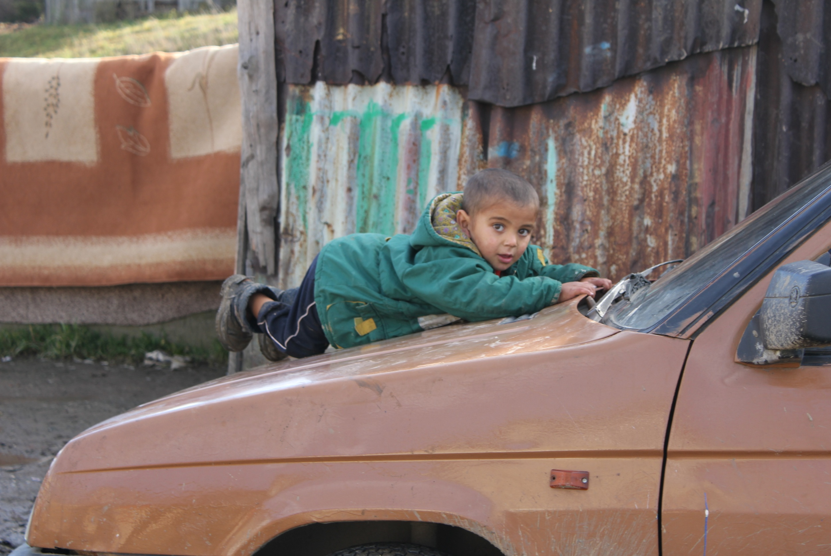

Slide 5
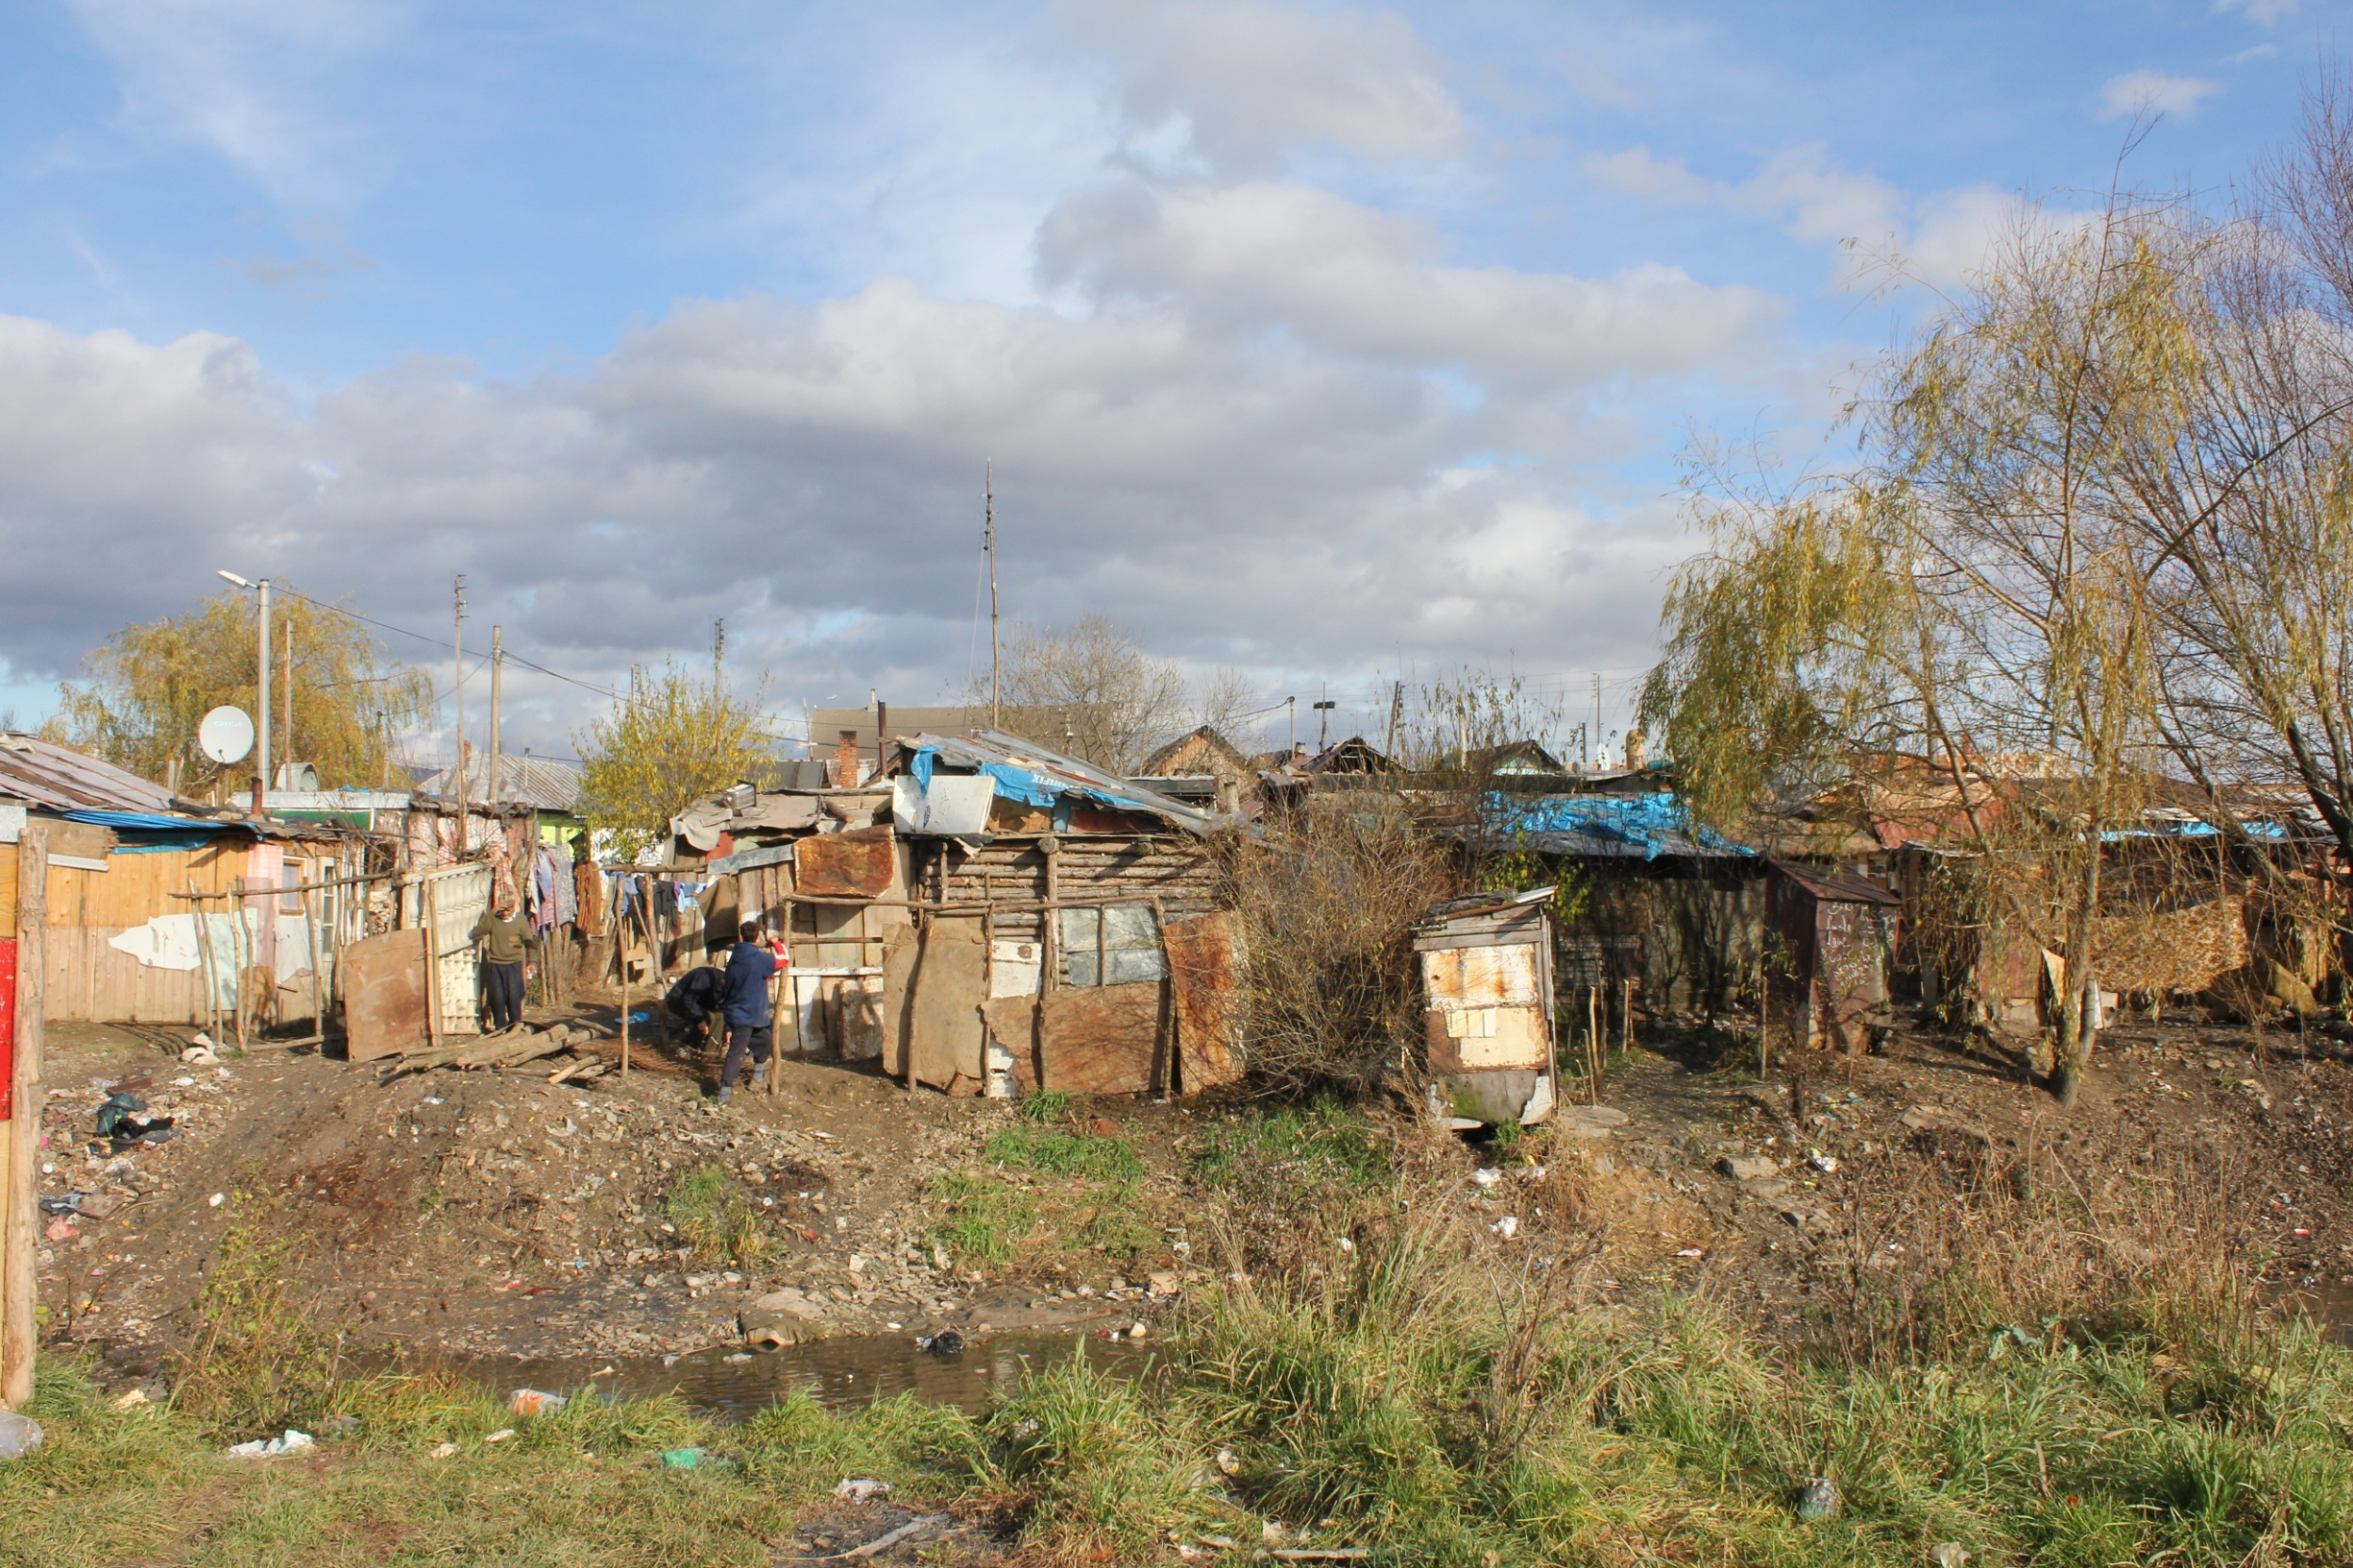

Slide 6
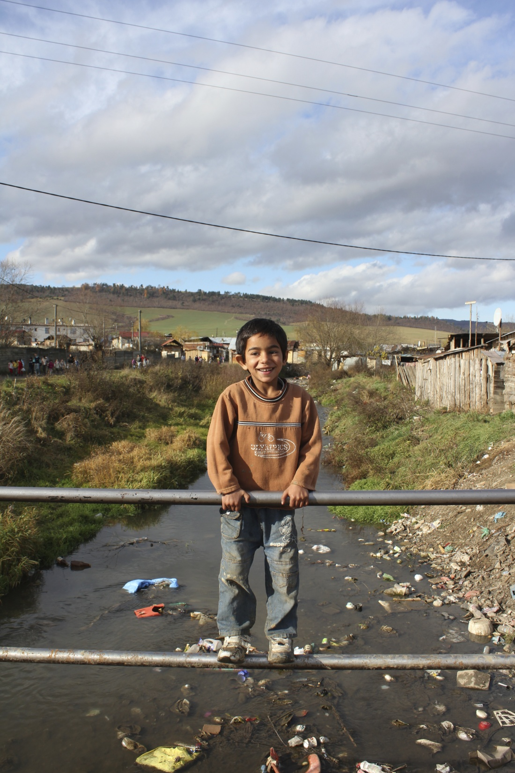
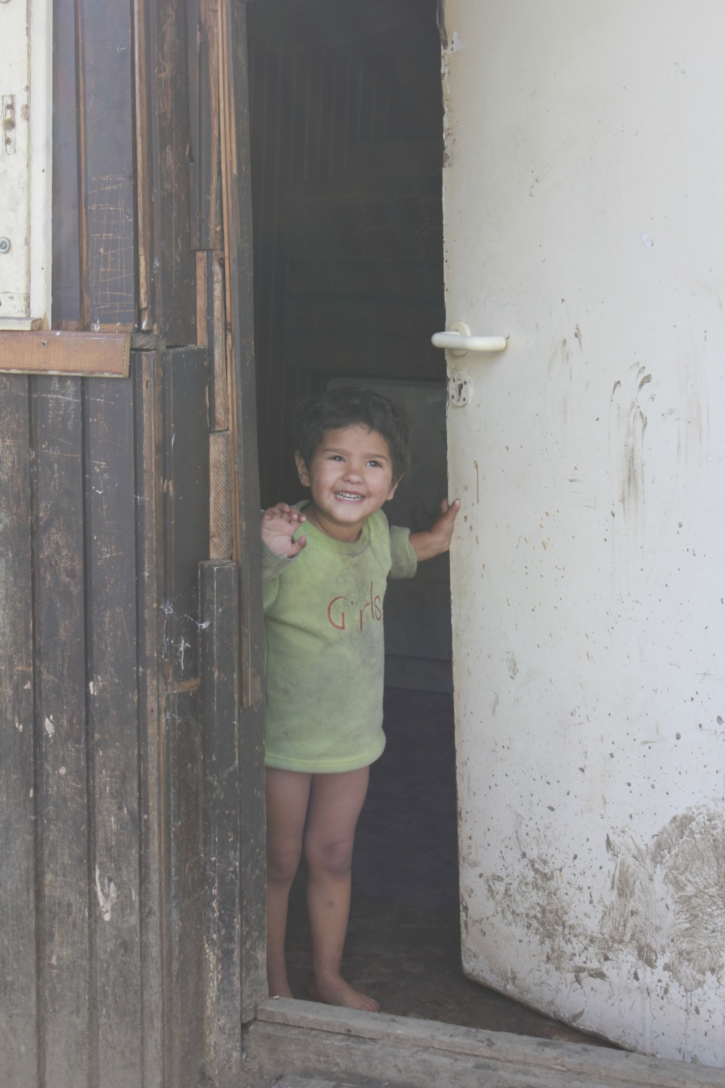

Slide 7
Together 4 Better Health
BG: National Network of Health Mediators
HU: Partners Hungary
RO: OvidiuRo Association
SK: Association for Culture, Education and Communication

Slide 8
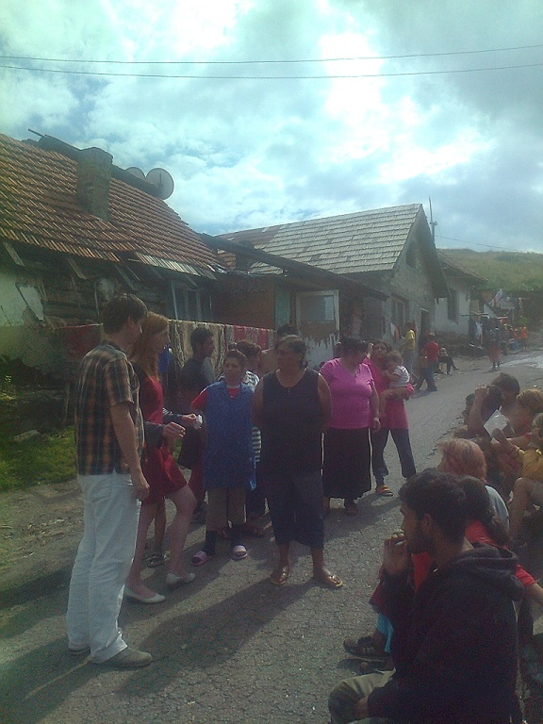
What do we want to achieve? Improving the health of Roma Children
SHARE and LEARN together:
Best practices in improving (access to) health for Roma children and direct support to Roma Health Mediators
Embed and improve the role of Roma Health Mediators in national legislation and structures
Secure sustainable funding, National & EU

Slide 9
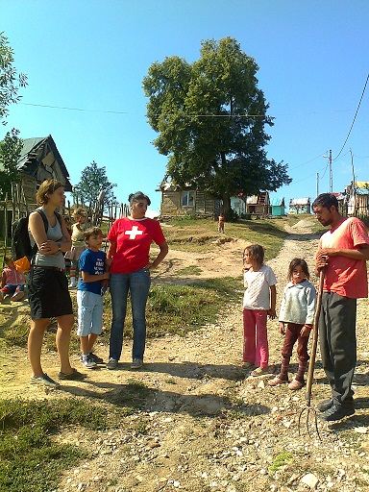
How do we work? ........Together!
4 times a year, 1x in person, 3x Video conferencing
Rotating Chair NGO´s
Pulse Volunteer
Supported by the European Public Health Alliance,
Supported by individual experts
Supported by GSK-passionate-colleagues
Expert and structural support
Meeting set up
Share and learn
Structure
Financing

Slide 10
What have we achieved?
Inspiration!
trained > 90 health mediators
and catalysed employment 4 many more
Benefitted nearly 150,000 children living across 115 Roma settlements
And passionate 4 many-many-more....

Slide 11
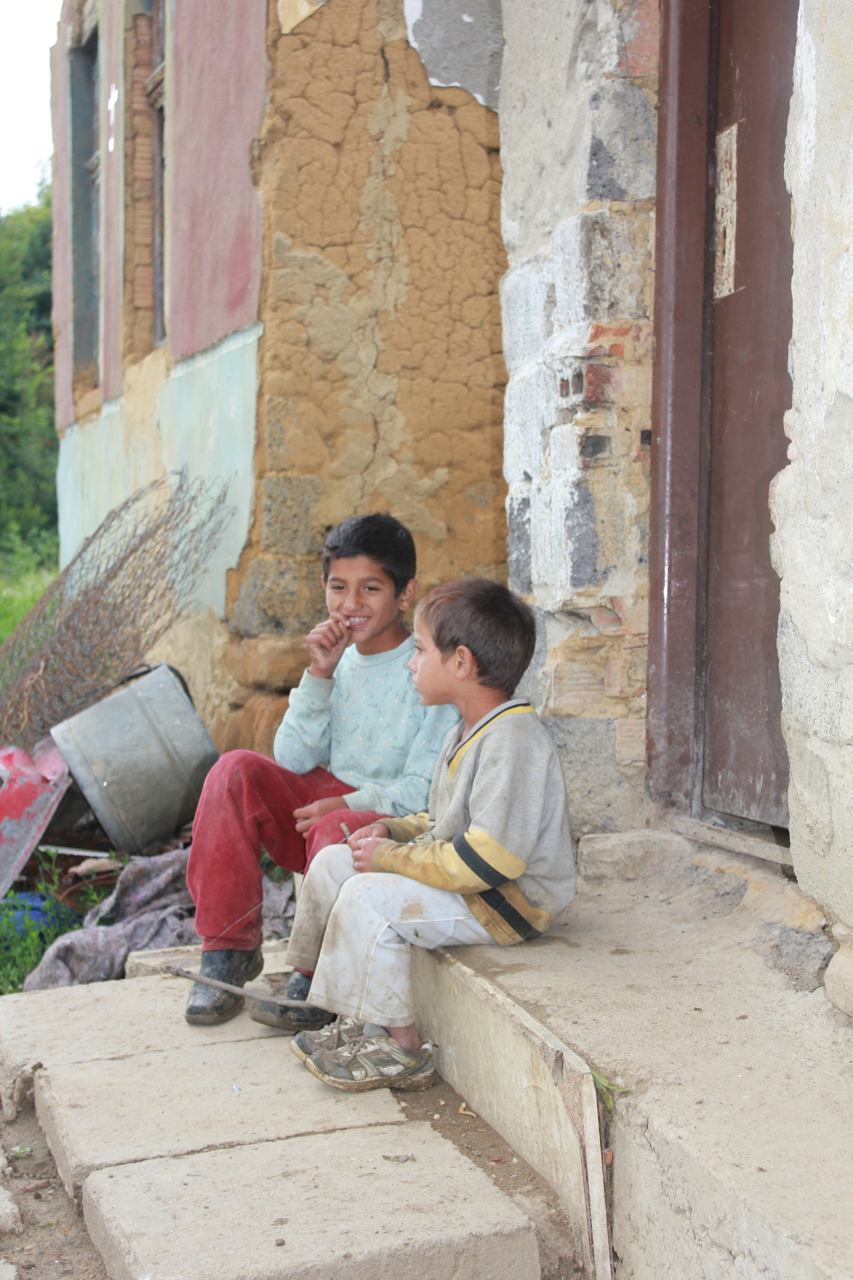
What´s next?
Reach more children
Further embed structurally
Secure sustainable Funding
Share learnings broader
Inspire others

Slide 12
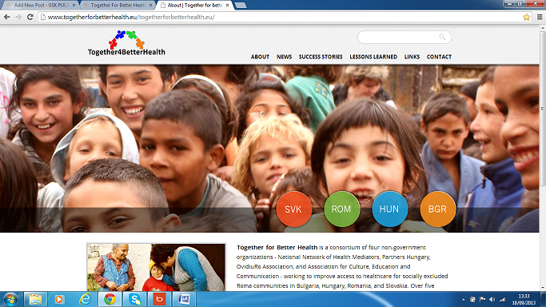
Share!

Slide 13
JOSEF has his ideas.... And i will help... And you?

Slide 14
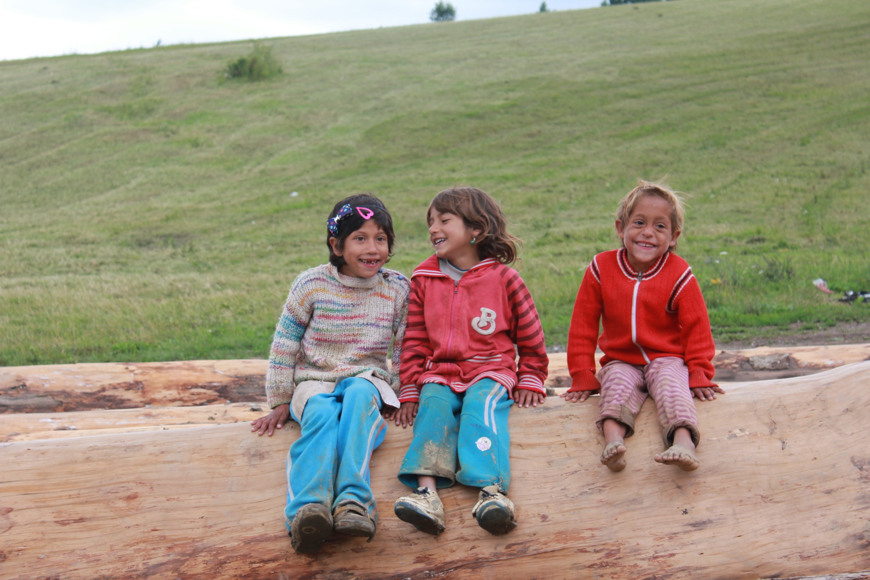
THANK YOU !, 4 being YOU...

